Slide 1
Xbox Storage
Xfest
August 23, 2000
Marc Whitten
Program Manager

Slide 2
Storage Principles
Don’t invent superfluous technology
  Leverage the Win32 API set — it is familiar, tested, sufficient
  Add architecture where it helps (save-game APIs)
Reliability is the priority
  Fat32 has faults — work around them
  Sacrifice write performance (and other areas) if it sufficiently enhances reliability
Separate data by use
  Implement management policies by these “regions”
Policy and code constraints are bad
  Storage is a value-add service; we don’t want to limit title creativity
  Limitations in place only where necessary for Xbox management and inter-title sandboxing

Slide 3
Xbox Storage Domain
Xbox hard disk
  Large (8 GB), always available, fastest
Xbox memory units
  8 MB at launch, potentially larger later; up to two per connected Xbox controller
Xbox online storage
  Sized similarly to an MU, requires extra code if you are not already a networked game, only storage with security (passcode protected)

Slide 4
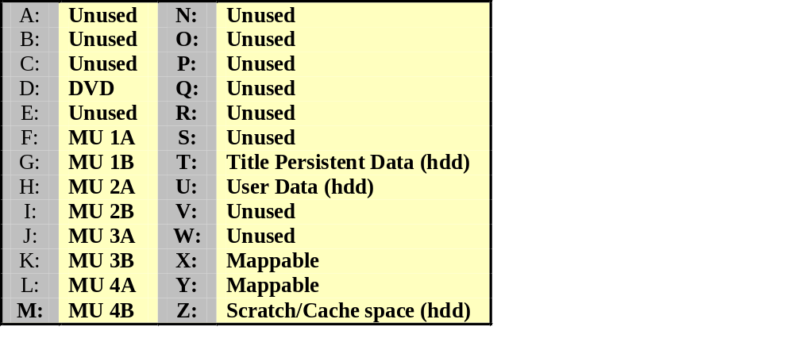
Xbox Storage Namespace
Data is separated by device type and use
Hard-coded drive letters provide access to a specific title’s area
  Not necessarily the drive root
  Implements weak sandboxing

Slide 5
Xbox Storage Regions
Scratch and cache
  Used for temporary storage of data; not guaranteed to remain from invocation to invocation
  Implemented as three 750-MB partitions, assigned on an LRU basis
  Title can keep data or have it cleared between invocations
Title storage
  Downloaded game additions
  Persistent global world data (not tied to a single user)
  Title managed, opaque to Xbox
Notes:
Talk about wether

Slide 6
Xbox Storage Regions (continued)
User storage
  Traditional “save game” storage (vague concept)
  Managed by the title and by Xbox
  Only storage that is roamable (hdd <-> mu <-> net)
Xbox Dashboard
  Different partition than the data regions above
  Holds the Dashboard code only — no settings
Settings
  Tiny amount of storage allocated outside the file system (512 bytes)
  Accessed via special API only
  Holds global Xbox settings (resolution, parental controls, etc.)

Slide 7
Save Games
Data must be saved in a simple hierarchy
Atomic unit of a save game is a directory
Two types of data stored:
  Title data, opaque to Xbox
  Metadata used to provide good experience within the Xbox Dashboard
Simple APIs to create, delete, and enumerate a title’s save games
  All other operations (write data, read data, etc.) use the standard Win32 file APIs
Saving to Web uses different method

Slide 8
Mapping Related Titles
APIs available to map in older versions of titles
  Example: Year 2 football game wants to import Year 1 playbook, etc.
  Limited number of map drives available; titles can only map related titles (e.g., by the same publisher)
Notes:
Talk about wether

Slide 9
File System Changes
All changes will be fully documented in the XDK
FASTFAT
Exclusively LFN (no SFN support exposed, no LFN tunneling cache, etc.)
Removed OEM character set support
Removed extended attributes
Removed file oplocks
Files are always stamped with UTC time
Removed support for pagefile.sys
Removed the fastio write path
Removed volume label support
Removed defragmentation support
Removed statistics support (perfmon)
Removed support for removable media
No longer zero memory when the file pointer is extended past the logical file end
Removed support for write-protected media
Removed file locking support
No concept of current directory
UDFS
All relevant changes above
Removed support for non-DVD/CD drives
#ifdef’ed version 1.02 vs. 1.50 support; evaluating final choice
Notes:
Talk about wether

Slide 10
Using the Disk
Some Ideas
  Downloaded levels, tracks, characters, etc.
  User-created levels, tracks, characters, etc.
  Updated sports stats (mirror the real NFL or PGA in game)
  Persistent worlds, from simple (tread marks, weapon damage) to extensive (complete fantasy world with persistent change, etc.)
  Employing user-selected and created music
  More extensive save games (though this comes with requisite problems in roamability)
  Cached data for faster seeks and loading (is the pain of getting this to the disk worth the improvement?)
  Saving user games
Notes:
Talk about wether

Slide 11
The DVD
DVD is a constant angular velocity (CAV) system
  Layout is key; titles need the capability to lay out the DVD in the optimal manner; more frequent, more time critical pieces need to be laid out so that they can be streamed the fastest
  We will provide tools to automate content layout
Notes:
Talk about wether

Slide 12
Summary
Please use the feedback form to give us feedback on what you’ve heard!
This talk was given by:
  Marc Whitten, Xbox Storage
Questions?

